Slide 1
Unsupervised Learning Capstone Project
Marcus Hendricks

Slide 2
Contents
Executive Summary 3
Problem Summary 4
Solution Summary 5
Recommendations for Implementation 8
Appendix 11

Slide 3
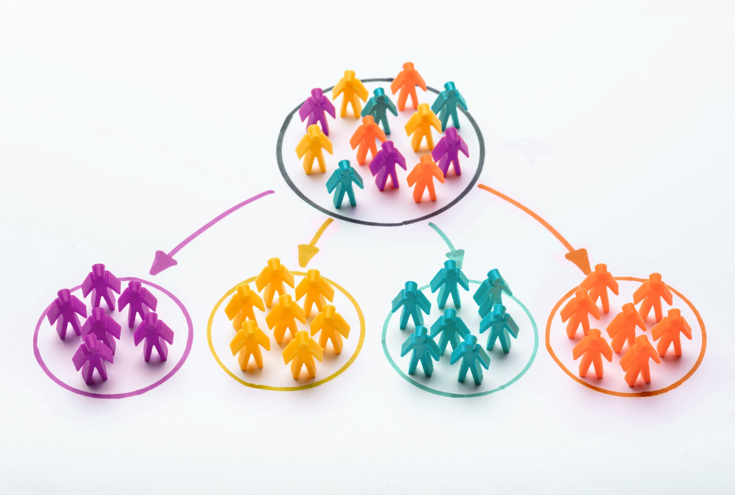
Executive Summary
Companies want to get to know their customers better and to increase their profits
Customer Segmentation is the process of dividing a dataset of customers into groups of similar customers based on certain common characteristics
Benefits
Optimize Return on Investment
Makes marketing more efficient
More Customer retention and engagement
Brand awareness
Notes:
Companies want to get to know their customers better and to increase their profits
Customer Segmentation is the process of dividing a dataset of customers into groups of similar customers based on certain common characteristics
Customer segmentation is important because:
Optimize Return on Investment
Makes marketing more efficient
More Customer retention and engagement
Brand awareness
There are plenty of examples that show it has a had a huge impact on email engagement and has even caused up to 6-7x the growth in revenue due to customer segmentation

Slide 4
PROBLEM Summary
A company has given a dataset with 27 Columns and 2240 data entries, with numerical and categorical variables ranging from income to education to various spending habits, and would like the best possible customer segments created using Unsupervised Learning ideas such as Dimensionality Reduction and Clustering
Customer Dataset
What features/variables have the most correlation?
What variables have the most variance in the customers?
What are the most important variables to consider when segmenting customers?
Things to consider: Variables
What is an appropriate number of clusters for segmenting customers?
What are the cluster profiles, and how are they different?
How can the cluster profiles be used to target customers for growth and increased revenue?
Things to consider: Clusters
Things to consider: Campaigns
How can campaigns be customized based on cluster profiles for a higher acceptance rate?
Notes:
Here is the summary of the problem that was given:
A company has given a dataset with 27 Columns and 2240 data entries, with numerical and categorical variables ranging from income to education to various spending habits, and would like the best possible customer segments created using Unsupervised Learning ideas such as Dimensionality Reduction and Clustering
Given this problem, there a few things I had to consider going into the problem:
What features/variables have the most correlation?
What variables have the most variance in the customers?
What are the most important variables to consider when segmenting customers?
What is an appropriate number of clusters for segmenting customers?
What are the cluster profiles, and how are they different?
How can the cluster profiles be used to target customers for growth and increased revenue?
How can campaigns be customized based on cluster profiles for a higher acceptance rate?

Slide 5
SOLUTION Summary
Explore/Clean Up the Data
T-SNE and PCA
Explore the data, clean up the data to make more sense of variables, feature engineer new variables, and univariate and bivariate analysis (See Correlation Plot)
Reduce the dimensionality of the data, visualize it in 2 dimensions, and help reduce the multicollinearity between the variables (See T-SNE and PCA Plots)
Use different Unsupervised Learning Methods and Algorithms
Compare and decide on best Clustering method
Use K-Means, K-Mediods, Hierarchical Clustering, DBSCAN, and Gaussian Mixture Models (GMM) to cluster customers into different segments
Compare segment customer profiles and Silhouette scores and decide on which method produced the best segmentation
Notes:
Here is my solution summary:
First thing I did was exploratory data analysis and clean up.
During this I looked at all the data, identified any missing data. One of the first things I noticed was the number of variables of 27. This would need to be reduced to make sense of the data
I began doing some univariate analysis on the data and noticed some outliers in the data and removed some of those data points because they would not give much insight for the data.
I then began to feature engineer new variables to make more sense of the categorical variables and make them easier to manipulate in the data, such as making a family size which combines marital status and kids and teens at home
I then did bivariate analysis of the data and looked to see if there were any significant correlations in the data. Wine and Meat Purchases had high correlation with expenses and were the only variables to have correlation above 0.85. These correlation may skew the data a little.
When the variables used in clustering are highly correlated, it causes multicollinearity, which affects the clustering method and results in poor cluster profiling (or biased toward a few variables). To help reduce the multicollinearity between the variables, I will need to use PCA to reduce variables.
I then scaled the data to avoid the problem of one feature dominating over others because the unsupervised learning algorithm uses distance to find the similarity between data points.
I then did T-SNE and PCA plots to reduce the dimensionality of the data.
My T-SNE plot did not seem to find much patterns in the data and would not be very useful
I then used different Unsupervised Learning Methods including K-Means, K-Mediods, Hierarchical Clustering, DBSCAN, and Gaussian Mixture Models (GMM) to cluster customers into different segments
I would then look at the clusterings, their silhouette scores, and the customer profiles those segments created and determine which method I believe created the best customer segmentation
I will show my findings in the next few slides

Slide 6
Solution Summary Cont.
Hierarchical Clustering (Ward Linkage and Euclidean distance)
K-Means
K-Mediods
Best K Value: K=3
Silhouette Score: 0.2691
Produced 3 fairly evenly distributed segments
Created High, Mid, and low-income groups
However, there are still outliers in the data and K-Means is affected by outliers, so these insights may not be totally accurate and should not be used
See K-Means PCA Scatter Plot
Best K Value: K=3
Silhouette Score: 0.2889
Produced 3 evenly distributed segments
Created High, Mid, and low-income groups with more distinct separations and insights in other variables than K-Means
See K-Mediods PCA Scatter Plot
Best K Value: K=3
Silhouette Score: 0.3149
Produced 3 less evenly distributed segments
Created very similar customer groups and K-Mediods, but there were some variables that had the groups not quite as distinct as K-Mediods
See HC Clustering PCA Scatter Plot
Notes:
K-Means
Best K Value: K=3
Silhouette Score: 0.2691
Produced 3 fairly evenly distributed segments
Created High, Mid, and low-income groups
However, there are still outliers in the data and K-Means is affected by outliers, so these insights may not be totally accurate and should not be used
K-Mediods
Best K Value: K=3
Silhouette Score: 0.2889
Produced 3 evenly distributed segments
Created High, Mid, and low-income groups with more distinct separations and insights in other variable than K-Means
Hierarchical Clustering (Ward Linkage and Euclidean distance)
I tested multiple HC methods and Ward Linkage and Euclidean Distance provided the most distinguishable dendogram, so I chose that method
Best K Value: K=3
Silhouette Score: 0.3149
Produced 3 less evenly distributed segments
Created very similar customer groups and K-Mediods, but there were some variables that had the groups not quite as distinct as K-Mediods

Slide 7
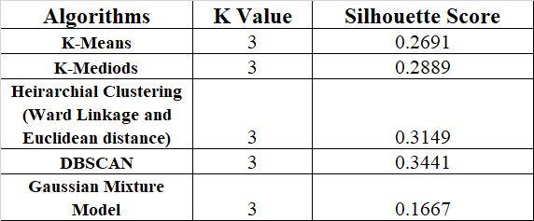
Solution Summary Cont.
Summary & Decision
DBSCAn
Gaussian Mixture Model (GMM)
Best K Value: K=3
Silhouette Score: 0.3441
Highest Silhouette Score
But resulted in only 2 clusters and they were not evenly distributed, so this method should not be considered
See DBSCAN PCA Plot
Best K Value: K=3
Silhouette Score: 0.1667 (Lowest score)
Explored K=5 segments (S score = 0.1462)
Created 5 segments that had some smaller groupings
Created 2x High, 1x Mid-High, 1x Mid, and 1x Low-income groups
This gave more insight into different income groups, but was not as clear and separated on many of the other variables
See GMM PCA Plot
Selected K-Mediods clustering
Most insightful profiles
Kept it simple
Higher Silhouette Score
Evenly Distributed Groups
Notes:
DBSCAN
Best K Value: K=3
Silhouette Score: 0.3441
Highest Silhouette Score
But resulted in only 2 clusters and they were not evenly distributed, so this method should not be considered
Gaussian Mixture Model (GMM)
Best K Value: K=3
Silhouette Score: 0.1667 (Lowest score)
Explored K=5 segments (S score = 0.1462)
Created 5 segments that had some smaller groupings
Created 2x High, 1x Mid-High, 1x Mid, and 1x Low-income groups
This gave more insight into different income groups, but was not as clear and separated on many of the other variables
Summary & Decision
Based off my findings, K-Means could not be used due to the outliers in the data, DBSCAN could not be used because it did not provide much insight, and GMM had a very low Silhouette score, so it came down to K-Mediods and Hierarchical clustering. Although, HC had a better Silhouette score, I think K-Mediods was a better clustering method in this case because it had better distribution amongst the different groups and slightly better insights from the customer profiles.
Selected K-Mediods clustering
Most insightful profiles
Kept it simple
Higher Silhouette Score
Evenly Distributed Groups

Slide 8
Recommendations for Implementation
Targeted Marketing using the 3 Clusters created by K-Mediods Clustering
Associate customer IDs and Cluster groups and create the 3 customer segments
Cluster 0 (Mid-income group) consists of mid to high income customers, who are the oldest age group, and typically have family size between 2-3, they have high web purchases and store purchases, spend a lot on wine similarly to cluster 2, they take advantage of the most deal purchases, have the most total purchases, and most have accepted 1 campaign.
This segment could be targeted with web and store deals, most of them are willing to accept campaigns, tend to make lots of smaller purchases, and could be very interested in wine deals.
Cluster 1 (Low-income group) consists of the lowest income group, they are the youngest age group and typically have the largest family size near 3, they have the least number of purchases across the board and typically accept 0 campaigns.
This segment may be harder to target due to their limited discretionary spending. However, they may be more willing to purchase deals or maybe products for their family since they typically have the largest family.
Cluster 2 (High-Income group) consists of the high-income group, who are middle age group in late 40s, who have a smaller family typically of 2 with 0 kids or teens at home, spend the most on wine and other products, they make lots of purchases via the catalog and store, they have the most expenses, highest amount per purchase, and accept the most campaigns on average around 1.
This group can be easily targeted by sending them catalogs for any products, especially wine, or have promotions in the store. They are also the most willing group to accept campaigns, so make sure to include them with those.
Notes:
Going forward:
Associate customer IDs and Cluster groups and create the 3 customer segments
Cluster 0 (Mid-income group) consists of mid to high income customers, who are the oldest age group, and typically have family size between 2-3, they have high web purchases and store purchases, spend a lot on wine similarly to cluster 2, they take advantage of the most deal purchases, have the most total purchases, and most have accepted 1 campaign.
This segment could be targeted with web and store deals, most of them are willing to accept campaigns, tend to make lots of smaller purchases, and could be very interested in wine deals.
Cluster 1 (Low-income group) consists of the lowest income group, they are the youngest age group and typically have the largest family size near 3, they have the least number of purchases across the board and typically accept 0 campaigns.
This segment may be harder to target due to their limited discretionary spending. However, they may be more willing to purchase deals or maybe products for their family since they typically have the largest family.
Cluster 2 (High-Income group) consists of the high-income group, who are middle age group in late 40s, who have a smaller family typically of 2 with 0 kids or teens at home, spend the most on wine and other products, they make lots of purchases via the catalog and store, they have the most expenses, highest amount per purchase, and accept the most campaigns on average around 1.
This group can be easily targeted by sending them catalogs for any products, especially wine, or have promotions in the store. They are also the most willing group to accept campaigns, so make sure to include them with those.

Slide 9
Recommendations for Implementation
Benefits
Increased Return on Investment for advertising/marketing
More tailored experience for the different customer groups
More willing to spend more
Improve customer retention
More brand awareness
Risks
Customers misclassified or belong to multiple segments
Causing customers to feel misaligned or alienated with the company
Customer segments could be too narrow or too wide
Further Analysis
Get more data to make segments more clearly defined
Clearly Define segment parameters so that you add new customers to their respective segment quicky
Notes:
Benefits
Increased Return on Investment for advertising/marketing
More tailored experience for the different customer groups
More willing to spend more
Improve customer retention
More brand awareness
Risks
Customers misclassified or belong to multiple segments
Causing customers to feel misaligned or alienated with the company
Customer segments could be too narrow or too wide
Further Analysis
Get more data to make segments more clearly defined
Clearly Define segment parameters so that you add new customers to their respective segment quicky

Slide 10
Questions?

Slide 11
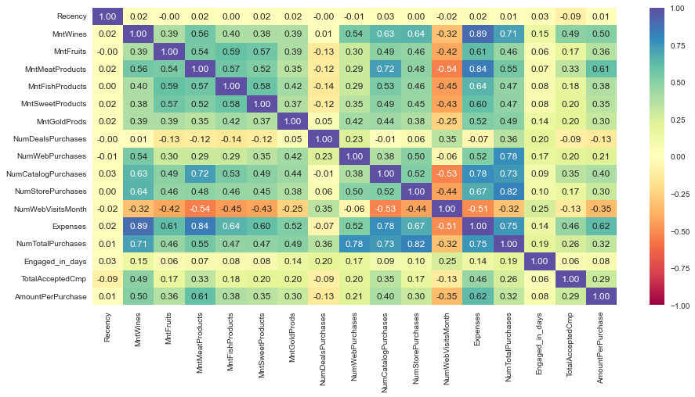
Appendix
Correlation Plot

Slide 12
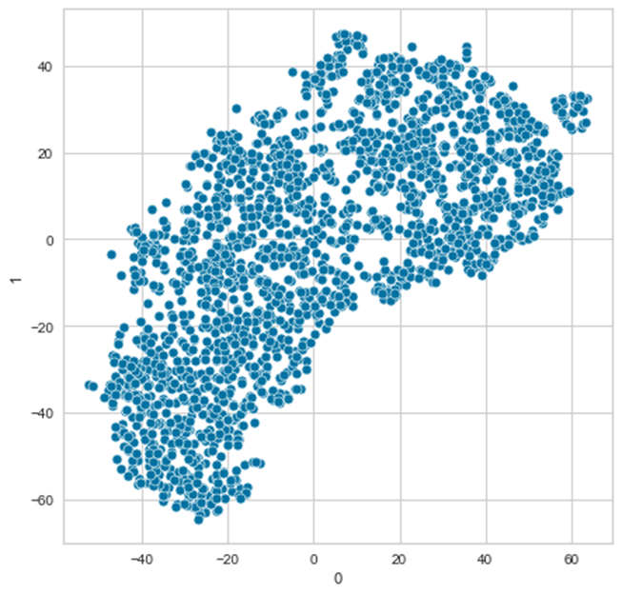
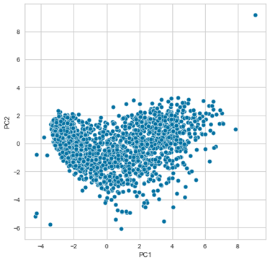
Appendix
T-SNE Plot
PCA Plot

Slide 13
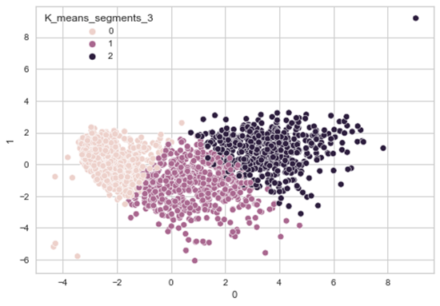
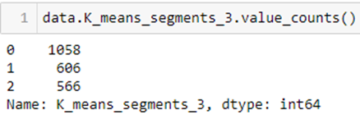
Appendix – K-Means
K-Means K=3 PCA Plot

Slide 14
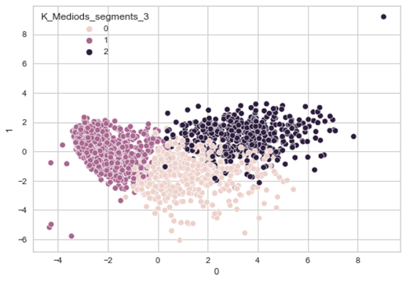
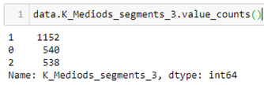
Appendix – K-Mediods
K-Mediods K=3 PCA Plot

Slide 15
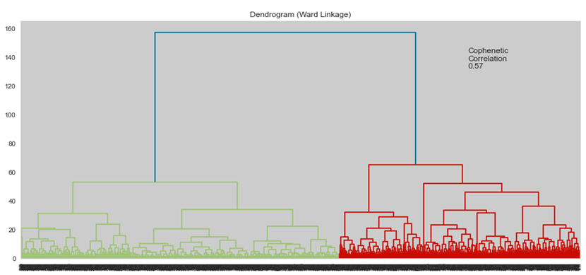
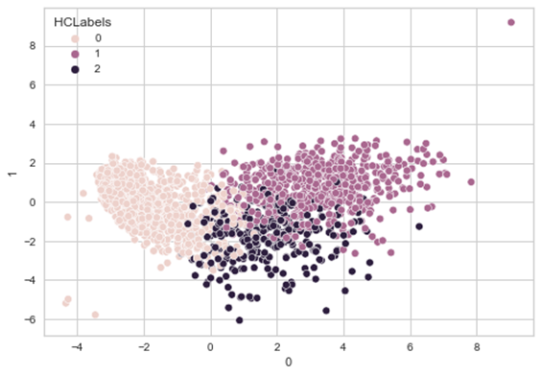
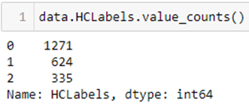
Appendix – HC Clustering
Euclidean distance and Ward Linkage dendogram
Hierarchical clustering K=3 PCA plot

Slide 16
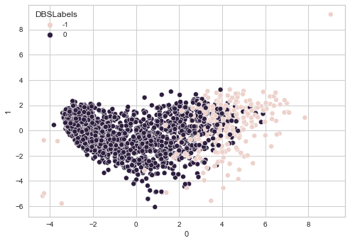

Appendix – DBSCAN
DBSCAN K=3 PCA Plot

Slide 17
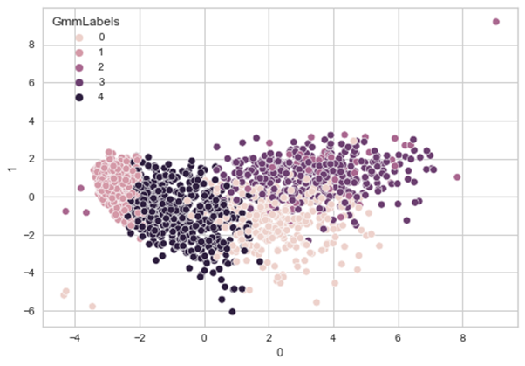
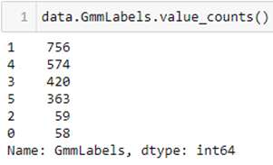
Appendix – GMM
Gaussian Mixture Model (GMM) K=3 PCA Plot

